Slide 1

healtheAT – Phase 5 deliverable/Demo
Group 3.2

Slide 2
Content
HealthEat
Research
Features
Design & Justification
Heuristic & Testing
Next Step

Slide 3
Our Vision
HealthEat is an app designed to merge all of the user’s food related routines and values into an inviting and convenient interface.
This way, we want to eliminate the huge mental load that goes into thinking what to buy and how to distribute it through the week.

Slide 4
What sets our application apart?
Our defining feature is the elimination of the standard scan and enter of conventional food tracking applications.
If you are shopping instore, HealthEat will connect directly to your grocery store rewards card.
If you shop online, HealthEat can order food directly from the app, import your current orders, and even keep track of the items arriving, and how to prepare them.

Slide 5
Is this application for you?
HealthEat’s target audience is people who want:
A simplified meal planning procedure.
Low effort calorie/nutrient tracking
To lower their amount of food waste

Slide 6
Other Notable Stakeholders
Supermarkets
Online Food Retailers
Fitness instructors
Local Governments
Health Care Systems
Insurance Companies

Slide 7
Research methods
Survey
Reason:
It is quick and effective
Help us elicit requirements and information
Allows us to collected data from a large sample of people
Extreme user interviews via personas
Reason:
Provide us with key highlights
These highlights leads to key design elements

Slide 8
Research findings
Our user research findings:
#1 reason people stop using other food tracking applications.
How often a person checks to see if they have expired food.
Amount of food purchased that is thrown away.

Slide 9
Must Have Features
Track contents of user’s fridge.
Automation of fridge updating.
Automation of ingredient ordering.
Food preference customization.
Recipe suggestions based on food near expiry.

Slide 10
Design Changes
Based on our heuristic feedback we:
Reduced the intensity of the colours.
Gave the application a softer look.
Added more information/help in the application.
Created a more user-friendly home page.

Slide 11
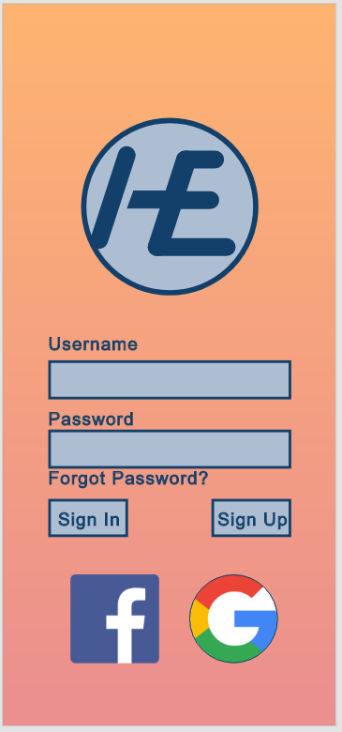
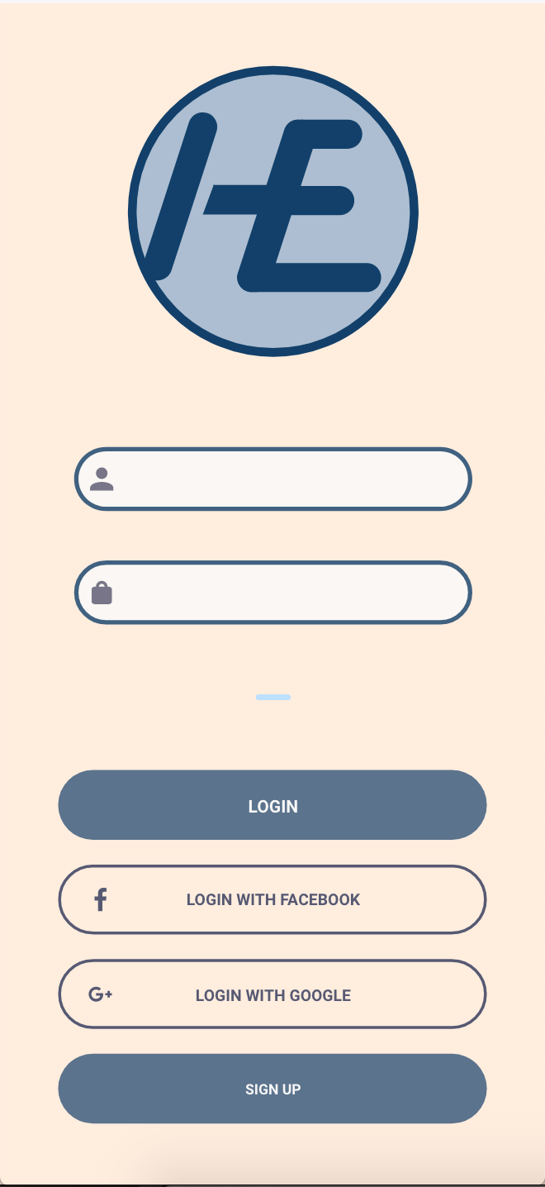
Design Changes
Login Page(Before)
Login Page (After)
Match between System and real-world

Slide 12
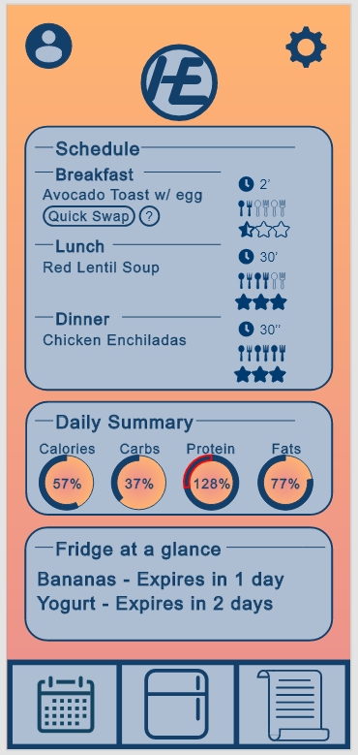
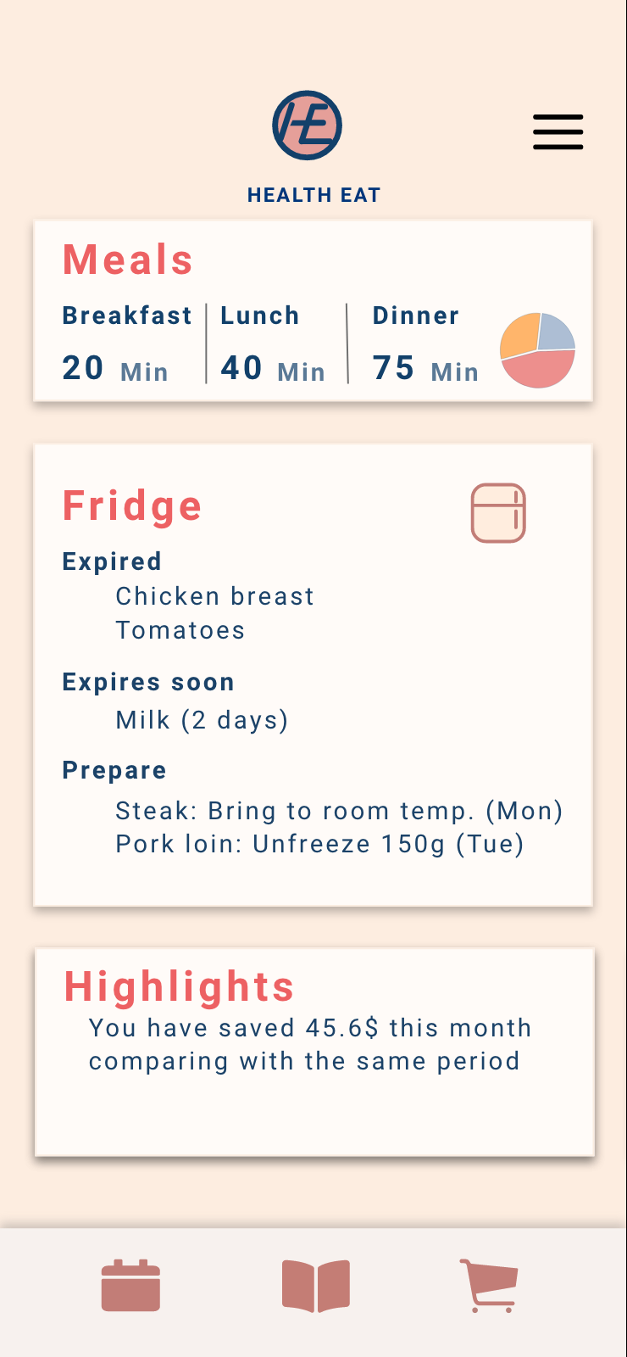
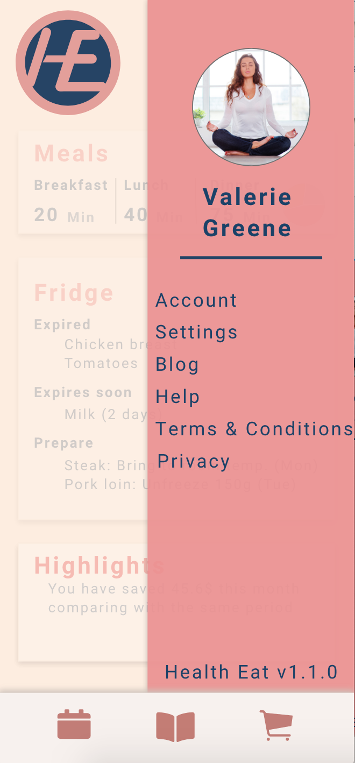
Design Changes
Home Page (Before)
Home Page (After)
Consistency and Standards

Slide 13
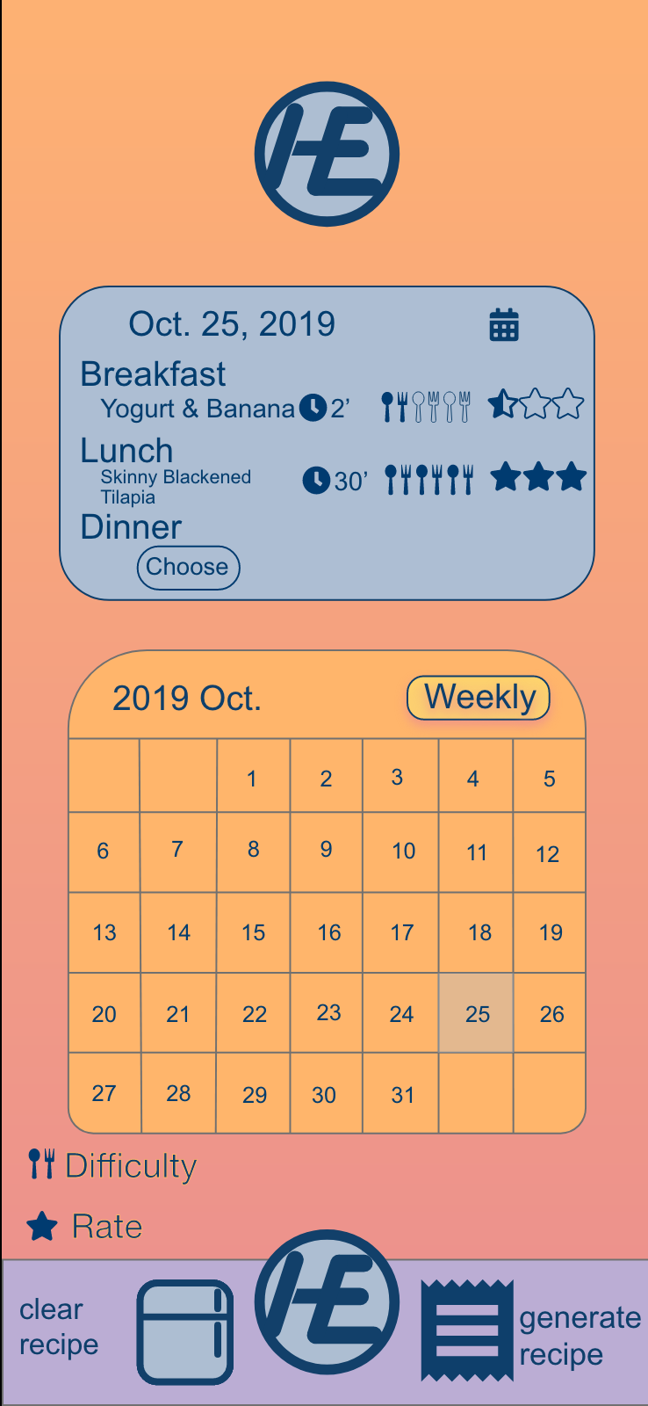
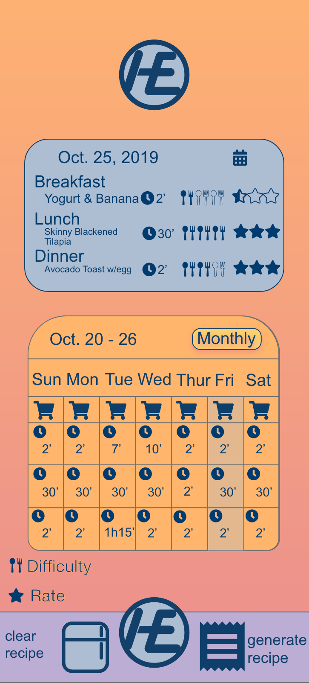
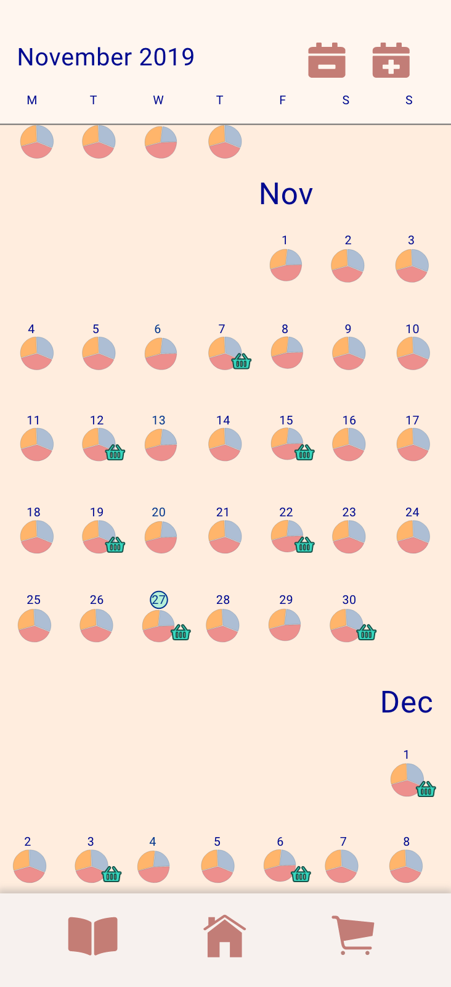
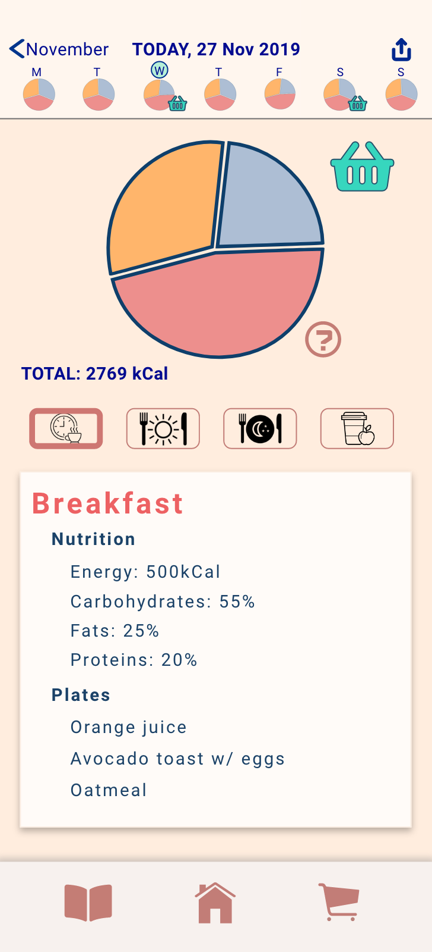
Design Changes
Calendar (Before)
Calendar (After)
Aesthetic and Minimalist design

Slide 14
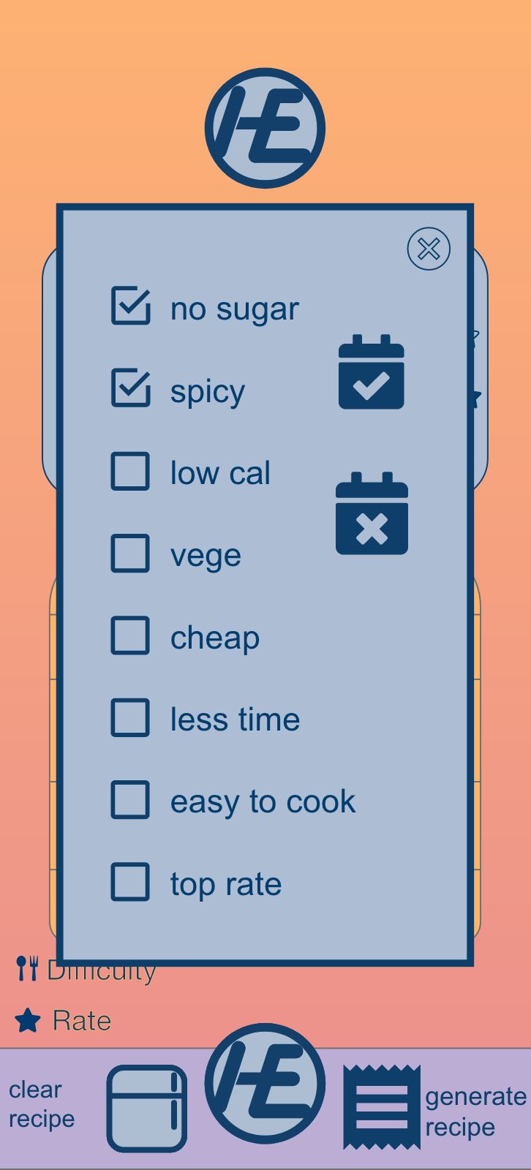
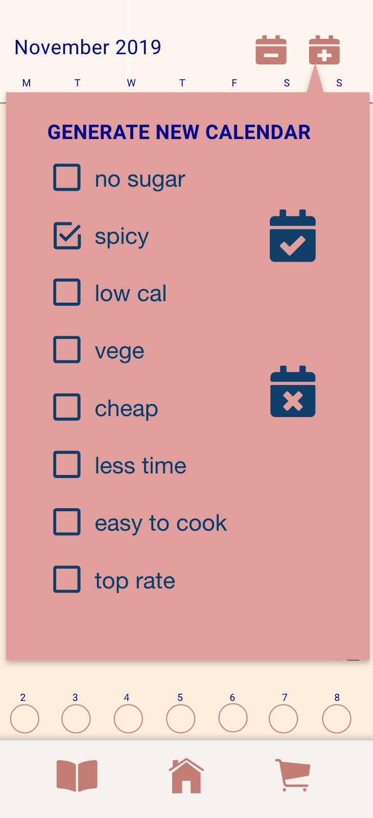
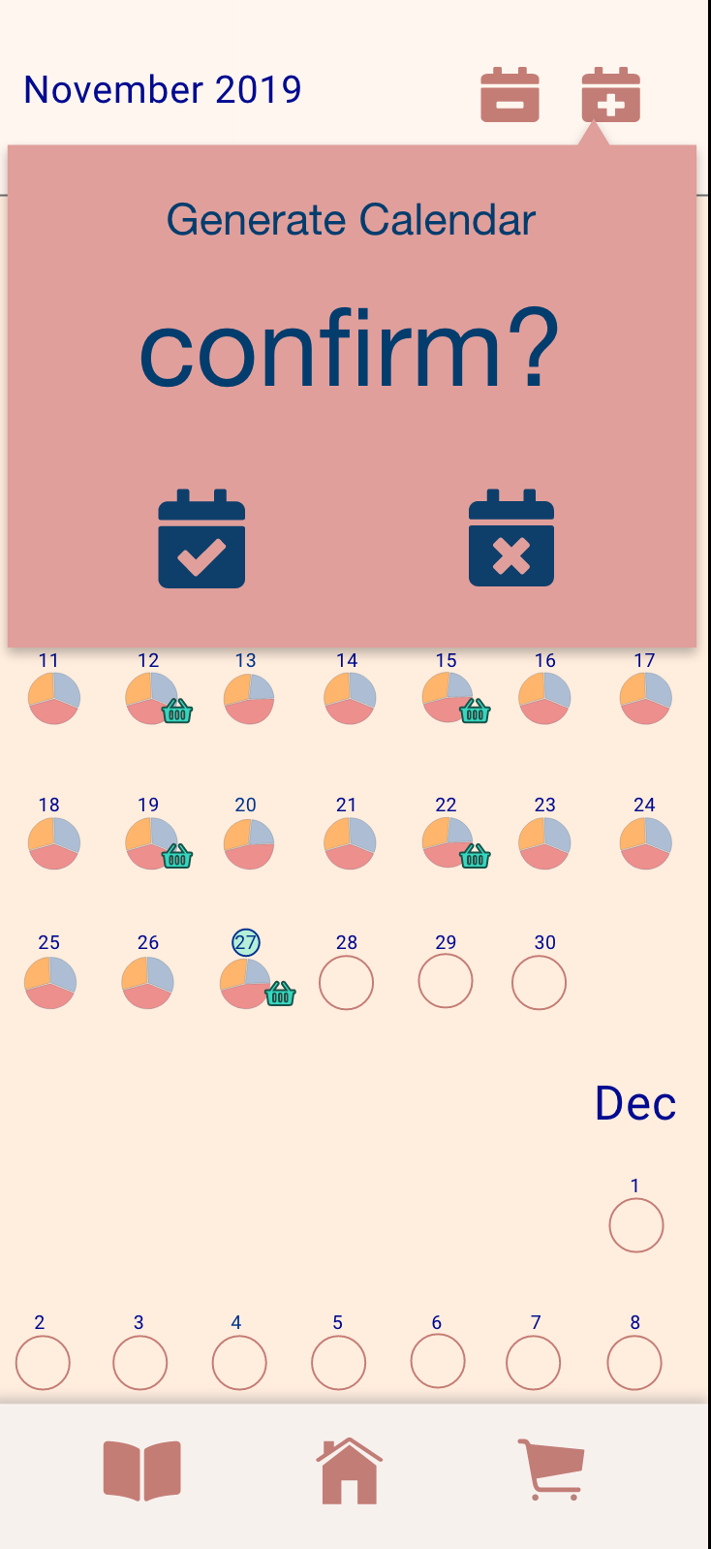
Design Changes
Generate Calendar
(Before)
Generate Calendar (After)
Error Prevention

Slide 15
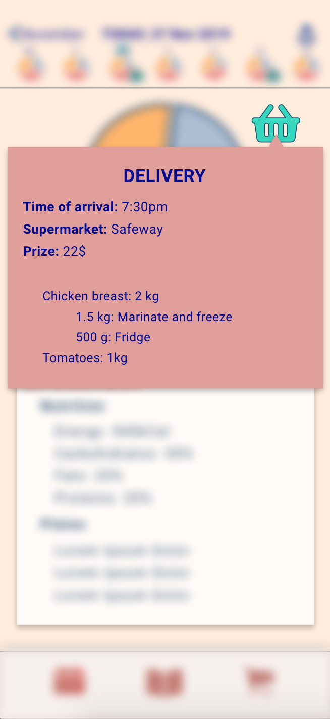
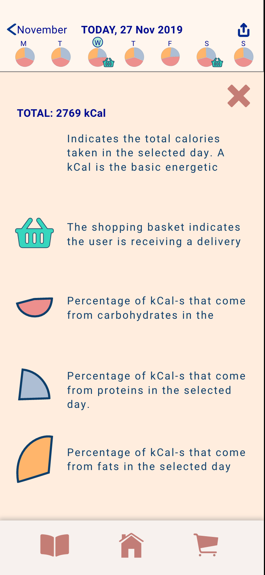
Design Changes
Helper (Add)
Helper (Add)
Help and Documentation

Slide 16
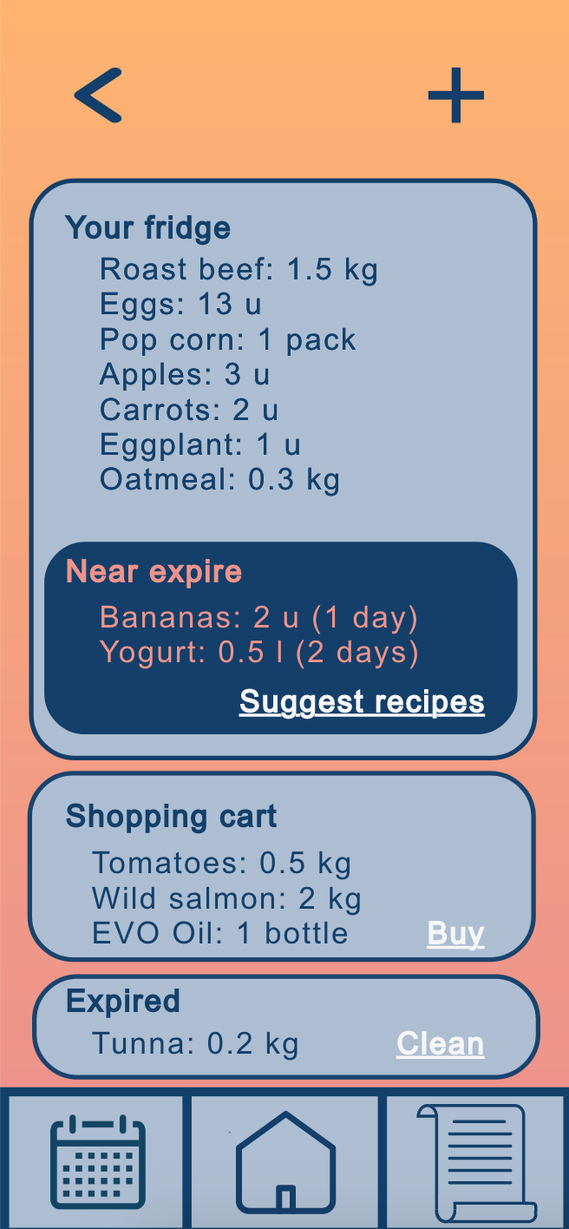
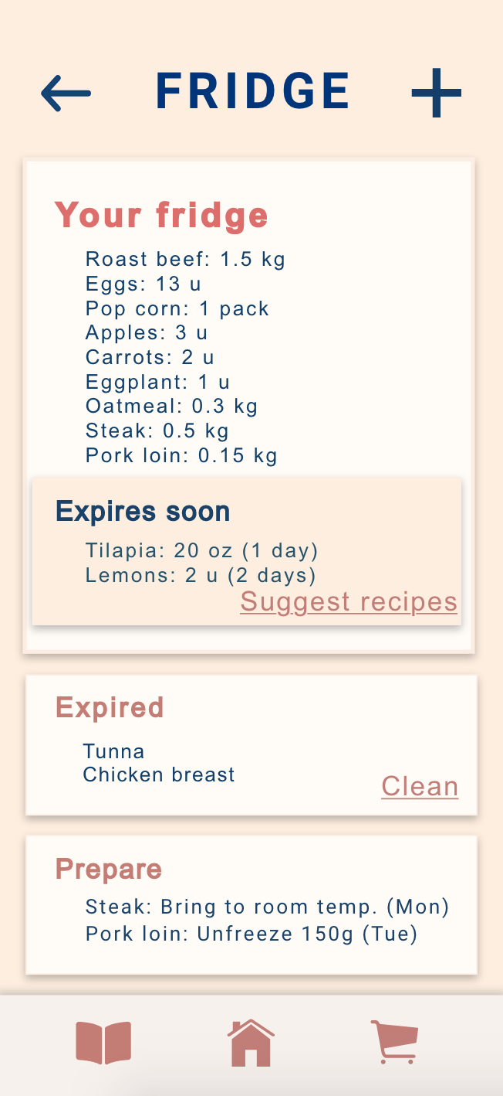
Design Changes
Fridge (Before)
Fridge (After)
Consistency and Standards

Slide 17
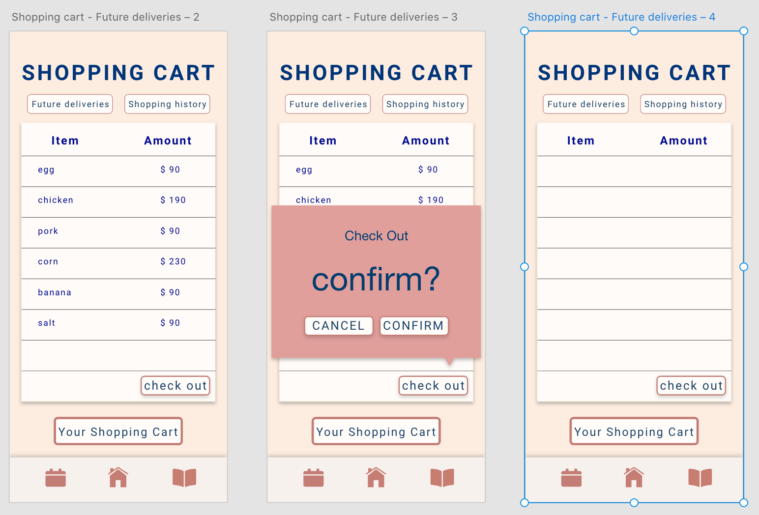
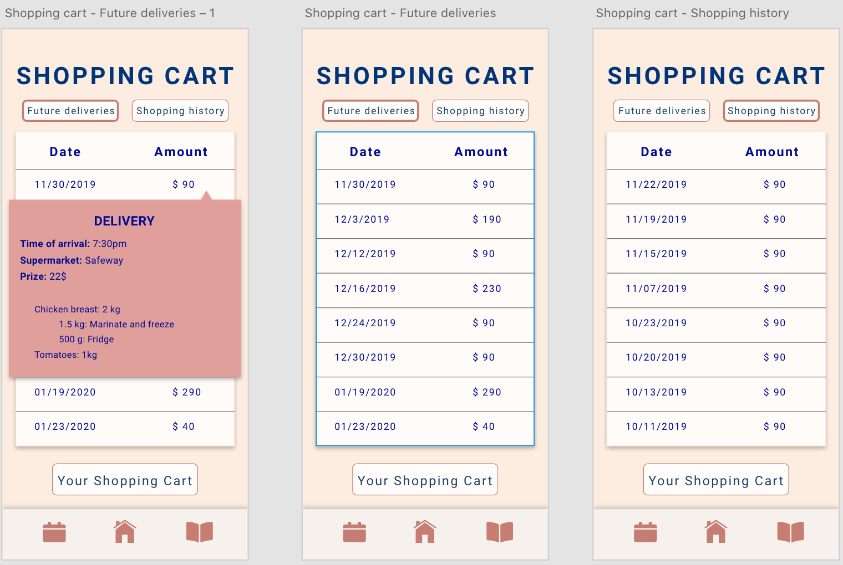
Design Changes
Shopping Cart (Add)
Match between System and real-world
Error Prevention

Slide 18
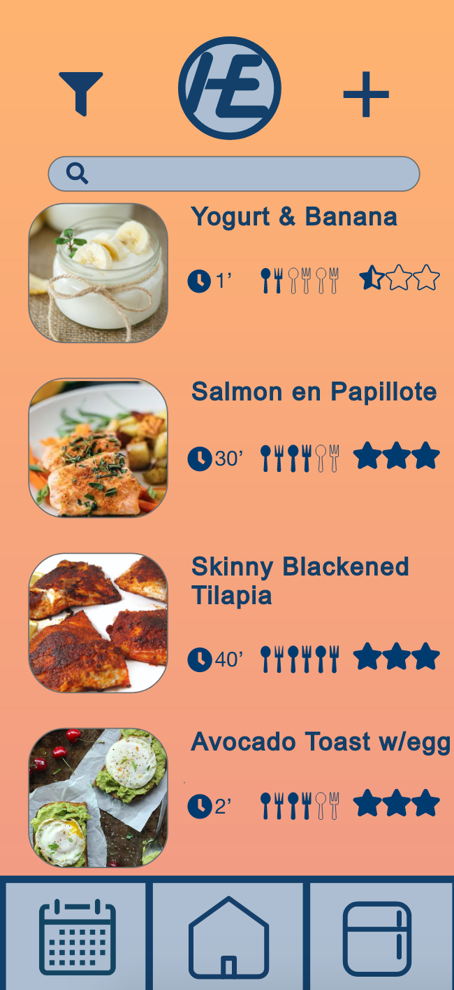
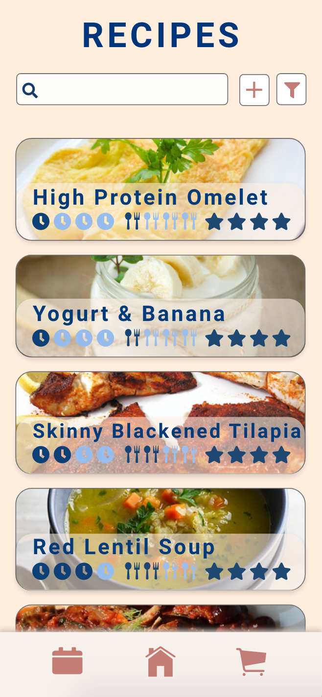
Design Changes
Recipe List (Before)
Recipe List(After)
Aesthetic and Minimalist design

Slide 19
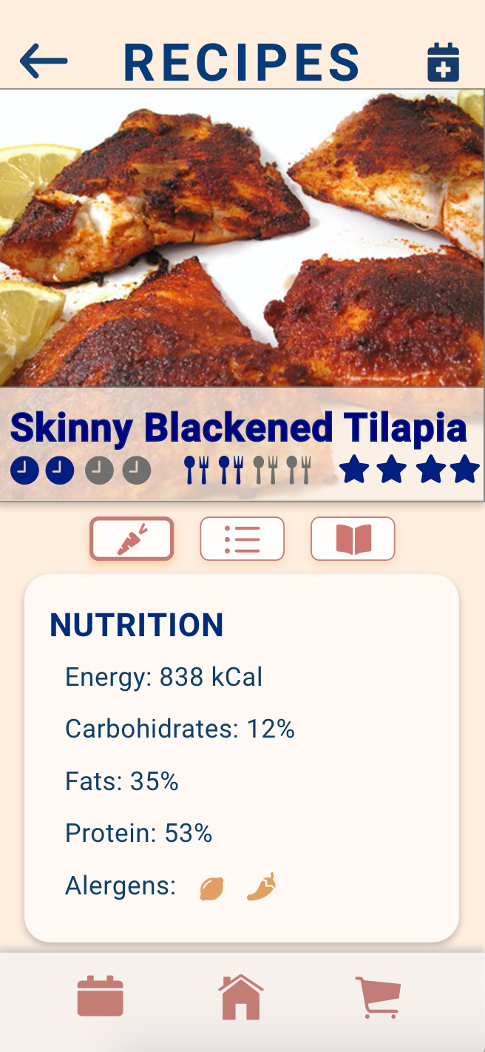
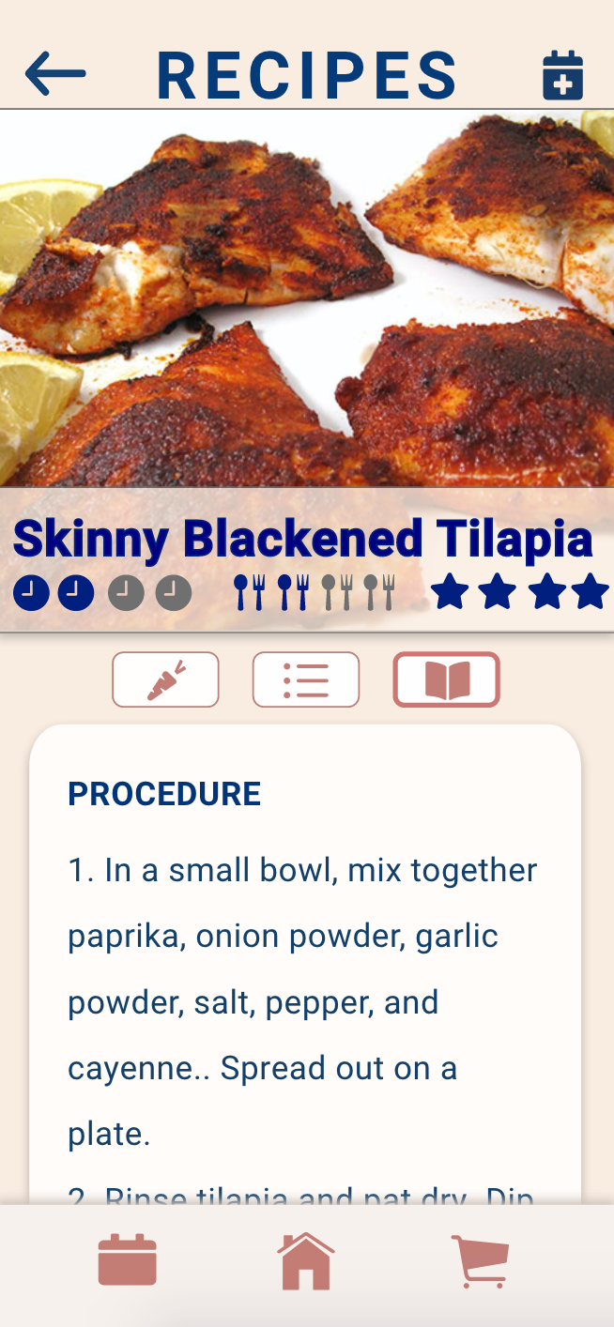
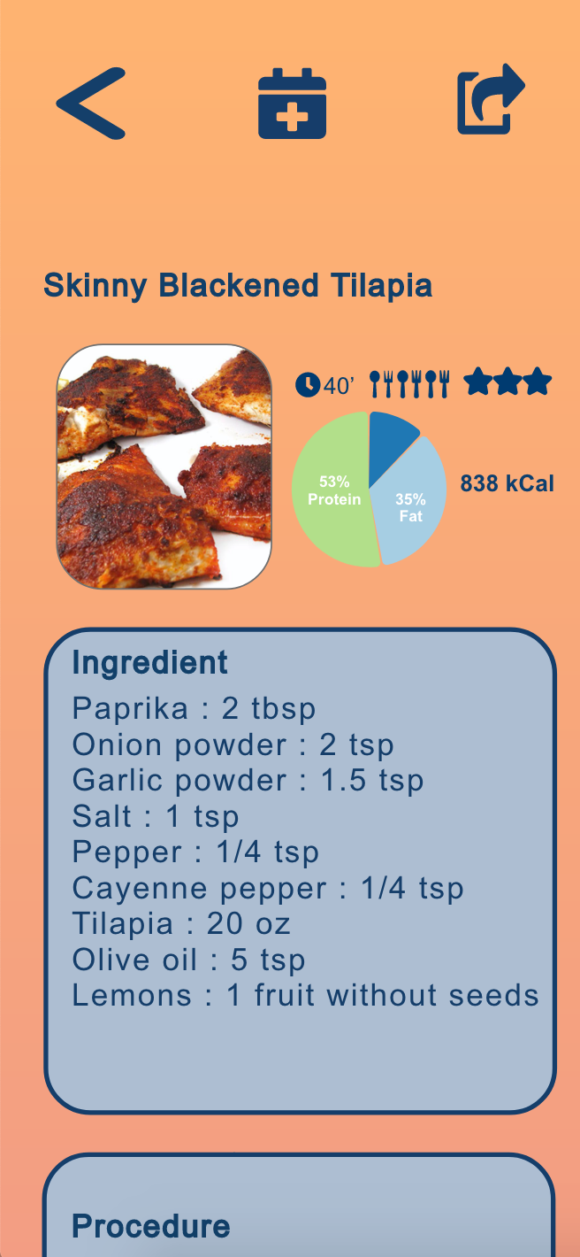
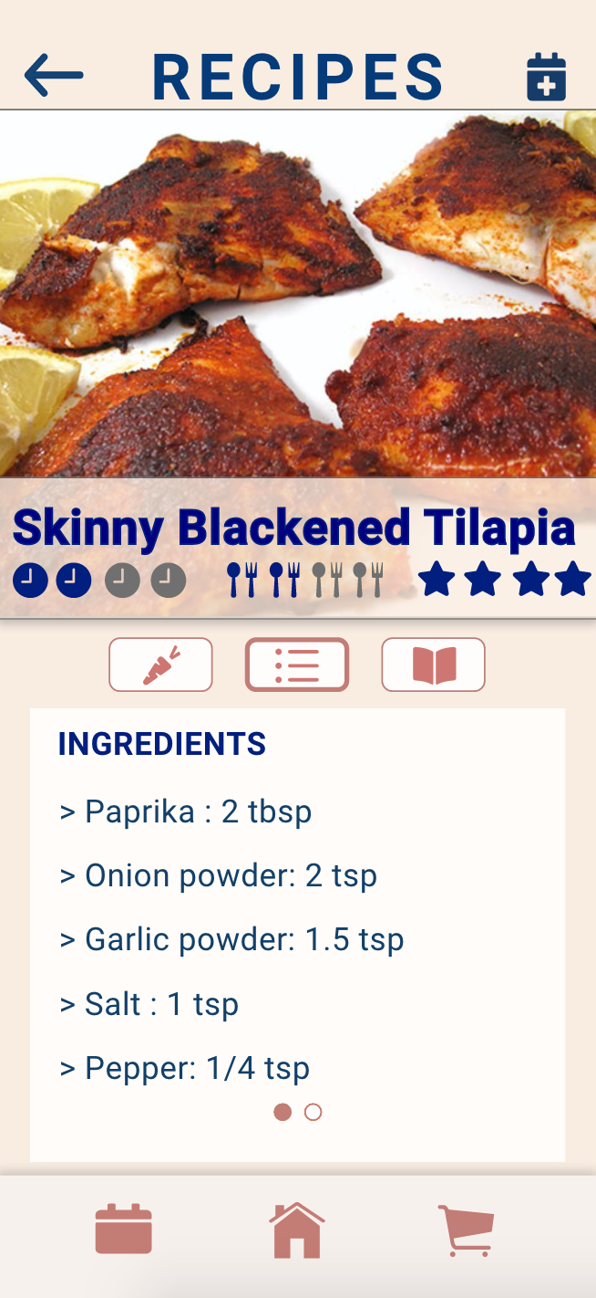
Design Changes
Recipe (Before)
Recipe (After)
Aesthetic and Minimalist design

Slide 20
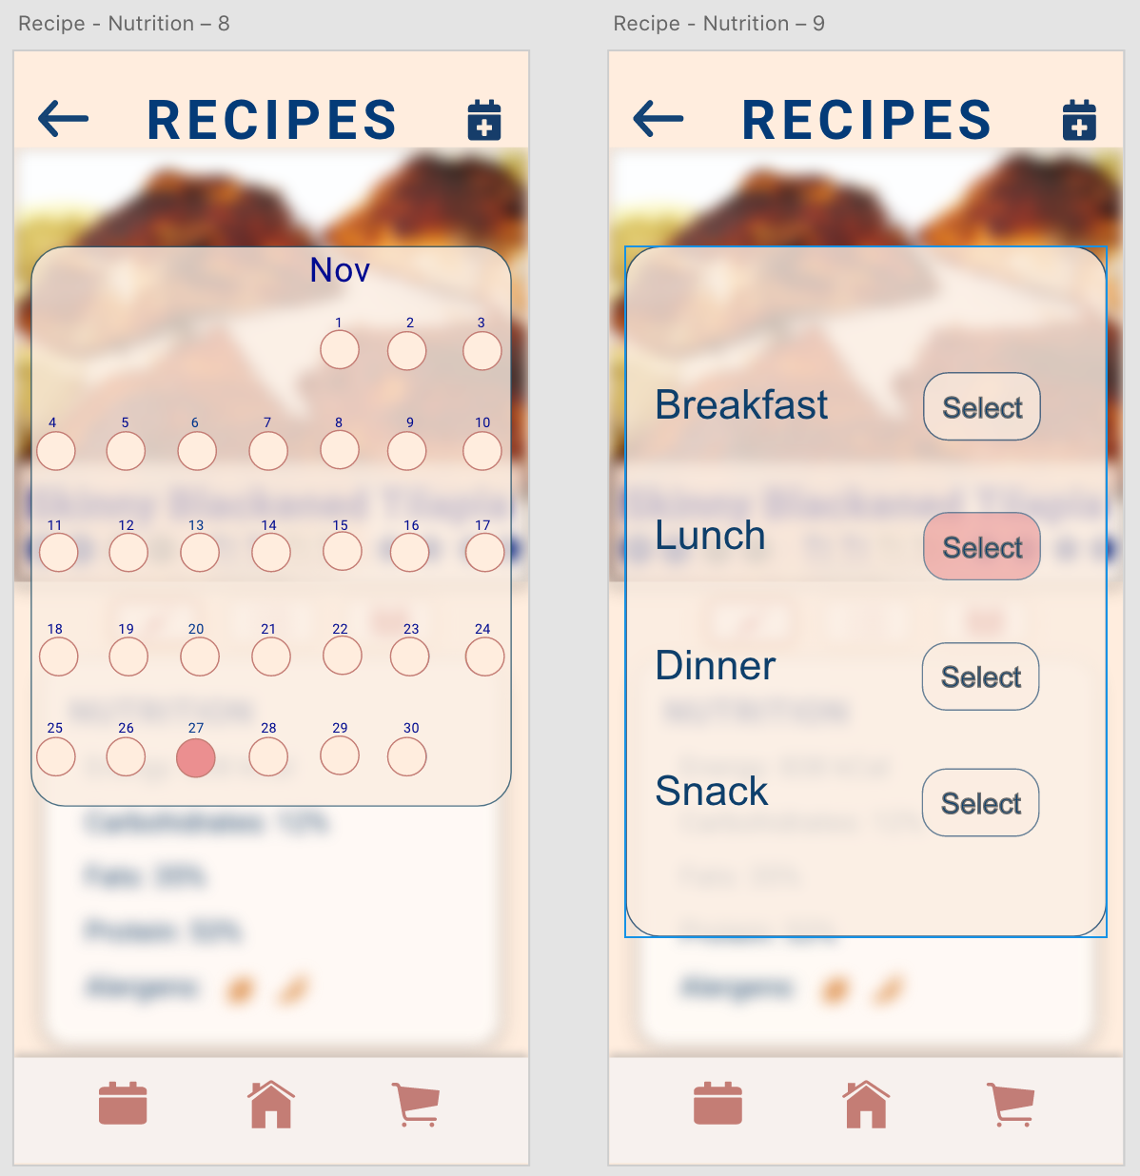
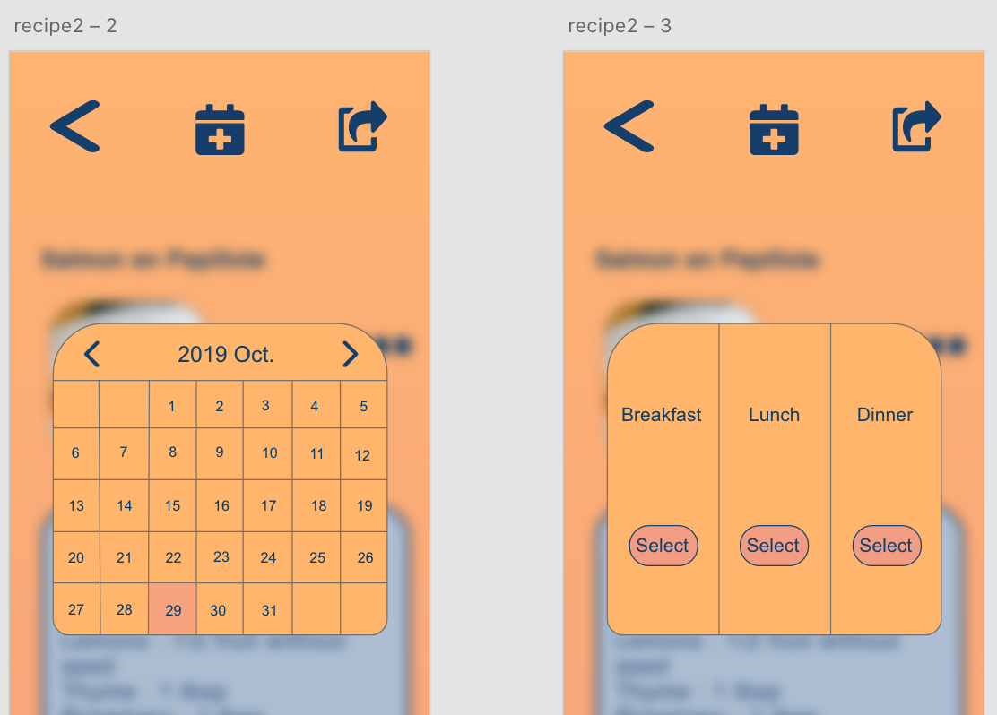
Design Changes
Add Recipe to Calendar(After)
Add Recipe to Calendar(Before)
Aesthetic and Minimalist design

Slide 21
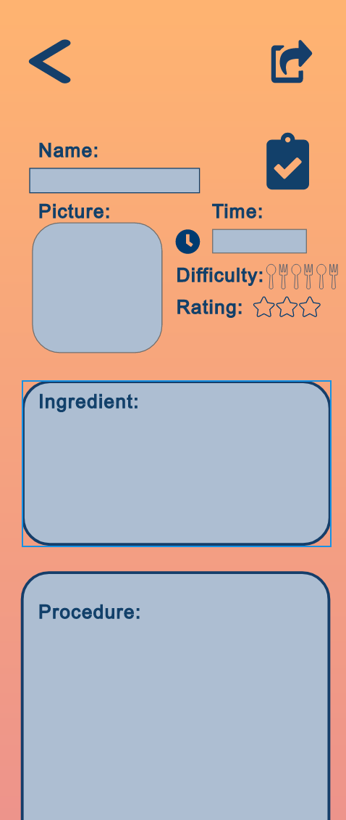
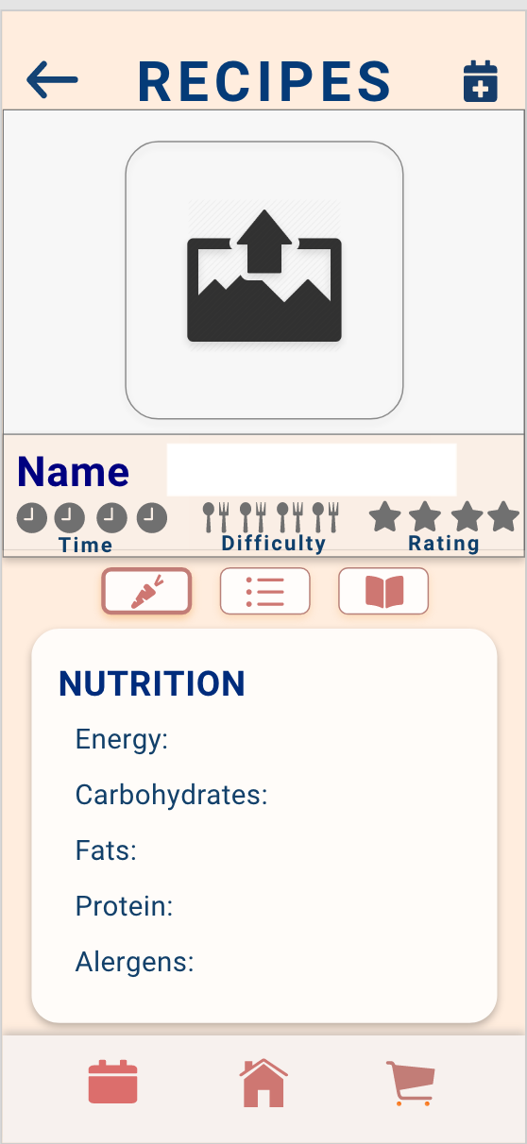
Design Changes
Add New Recipe(Before)
Add New Recipe(After)
Help and Documentation

Slide 22
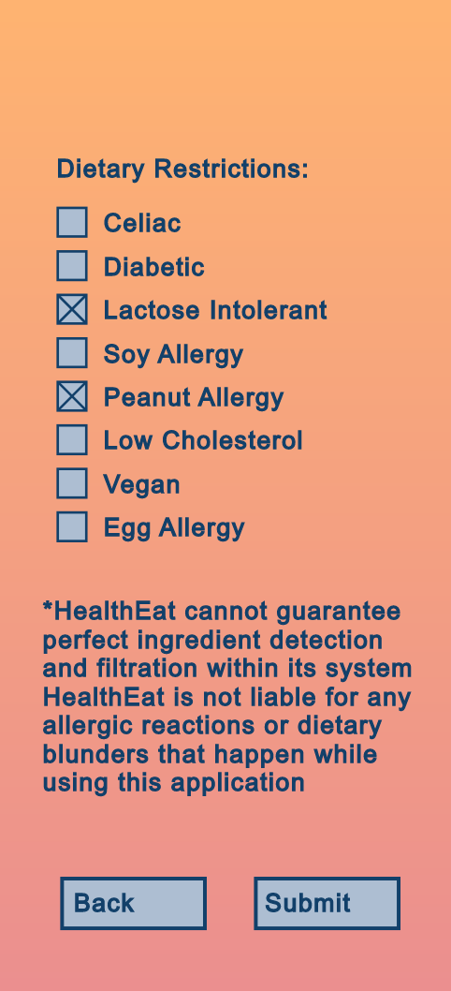
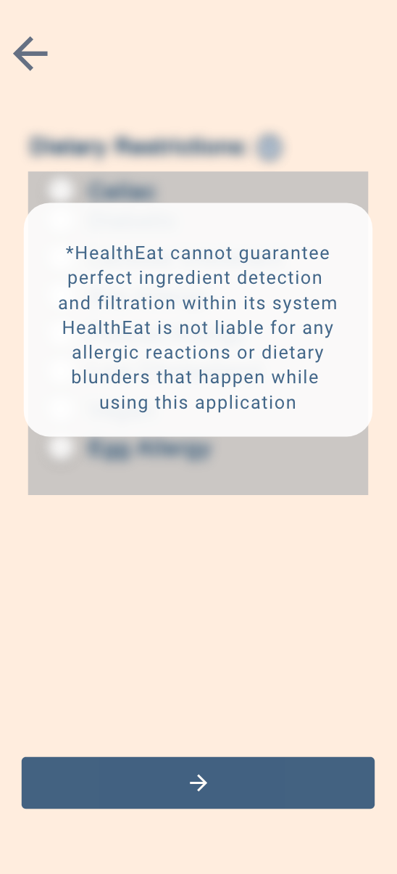
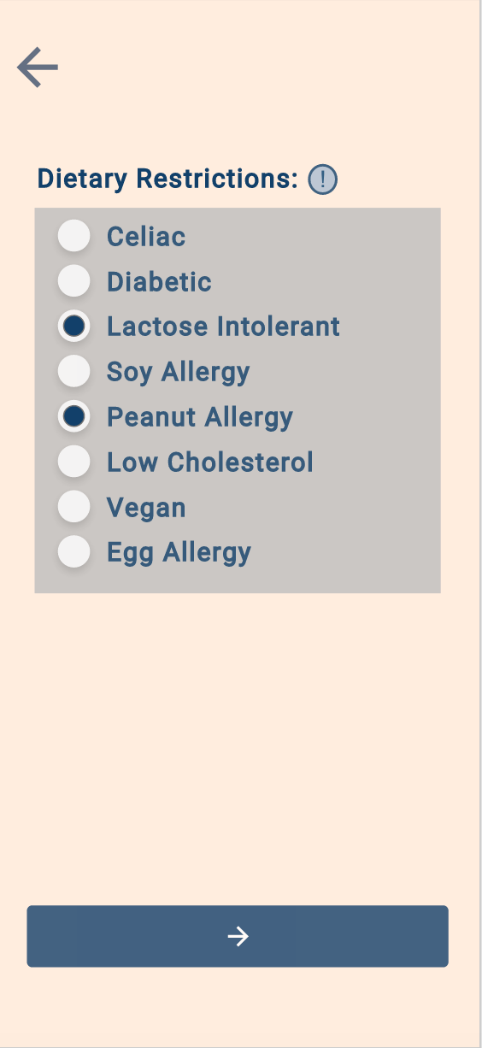
Design Changes
Sign-Up(Before)
Sign-Up(After)
Help and Documentation

Slide 23
Future Updates
Make the meals per day customizable
Add more help documentations
Support undo function
Add confirmation box for important message
Provide the special deal of today in the shopping cart

Slide 24
Thank you !

